Slide 1


Perceptions of wine quality
through visualization & machine learning Tyler Adams • Edgardo Bungay, Jr • Karen Graham

Slide 2
The Story
“Well, what is it about wine?”
The concept of quality is important in the food and wine industry.
Given its long history, the nature and features of wine quality are rarely explained.
Nevertheless, an examination of perception of wine quality is considerably valuable for consumer understanding of the aesthetic attributes and nature of wine.
The question we want to unveil is which variables correlate with the quality of wine and which machine learning methodology is useful and can develop a criteria which can frame and inform consumer purchase.

Slide 3
Data Source for machine learning
UCI offers a repository for machine learning that is publicly available for research.
Of two datasets, based on physicochemical tests, collected almost up to 5,000 wine samples for quality research.
Data output was created and downloadable in csv.
Using Python Pandas, Python Matplotlib, and tableau to create visuals and chart the features and explore machine learning modules.

Slide 4
Data Preparation & Description
12 input variables, objective tests + 1 output variable, based on sensory data
Data cleaning – handling nulls values in Tableau
Variables | Description
1. - Type | Red or White
2. - Fixed Acidity | Level of fixed acids (ex: tartaric, malic); low level = “flat”
3. - Volatile Acidity | Level of acetic acid; high levels = unpleasant, vinegar taste
4. - Citric Acid | Added in small quantities to add flavor
5. - Residual Sugar | Amount of sugar remaining after fermentation stops
6. - Chlorides | Amount of salt
7. - Free Sulfur Dioxide | Measure of the amount of SO₂ that is not bound to other molecules
8. - Total Sulfur Dioxide | Measure of both the free and bound forms of SO₂
9. - Density | Density of water depending on percent of alcohol and sugar content
10. - pH | Describes how acidic or basic; Scale between 0 (very acidic) to 14 (very basic)
11. - Sulphates | Level of sulfur dioxide gas (S02) added
12. - Alcohol | Percent of Alcohol
13. - Quality | Score between 0-10

Slide 5
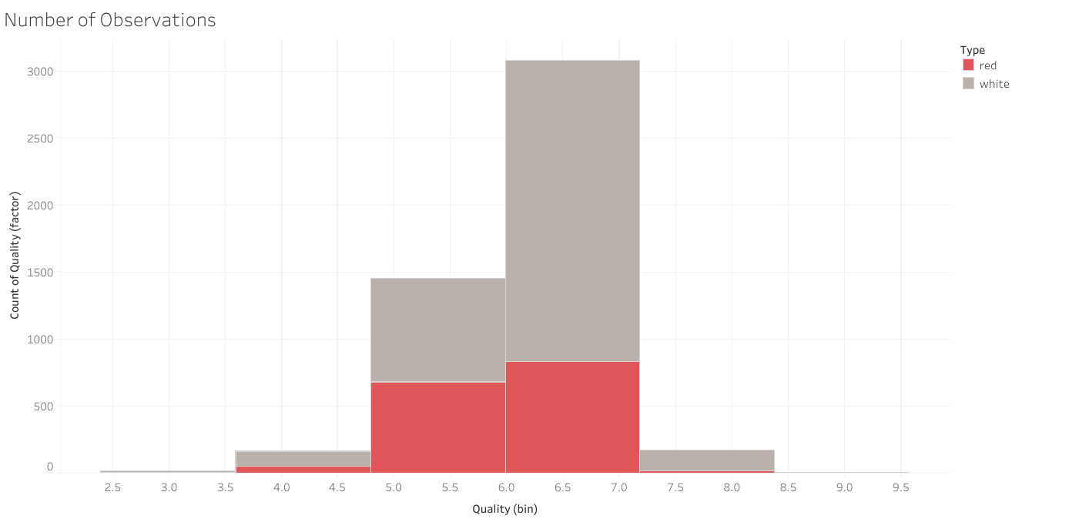
Understand the Distribution
Red Wine sample: 1600 total White wine sample: 4899 total
Both display a normal distribution with the same picks at 5 and 6 on quality points.

Slide 6
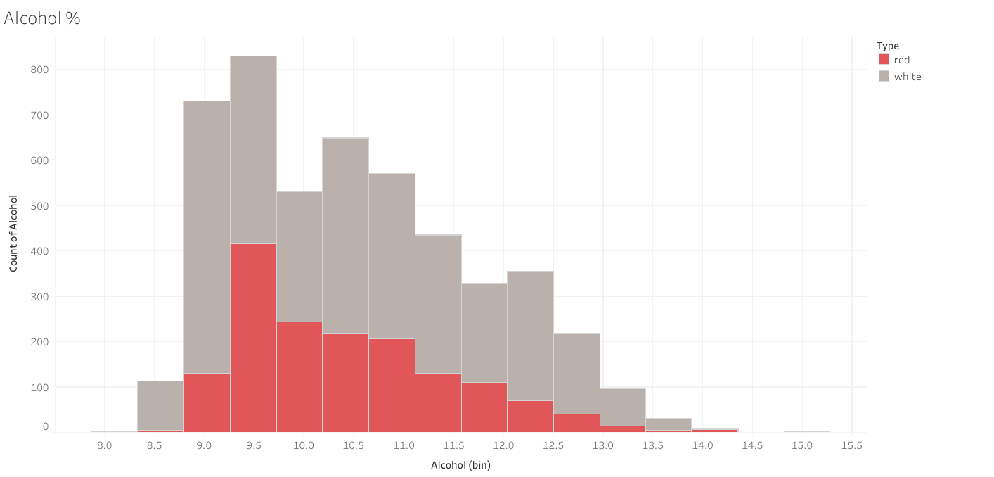
Level of Alcohol
Alcohol level distribution looks skewed. Again, red wine sample is smaller but it gives the same pattern of alcohol level distribution as white wines. Most wines have a 9.5%. The mean is 10.49% of alcohol.

Slide 7
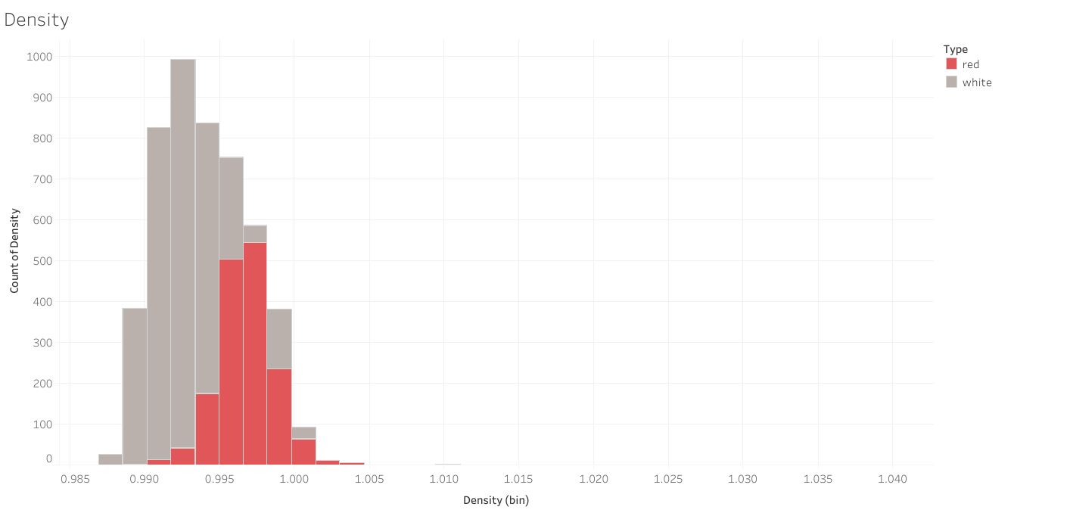
Density Comparison

Slide 8
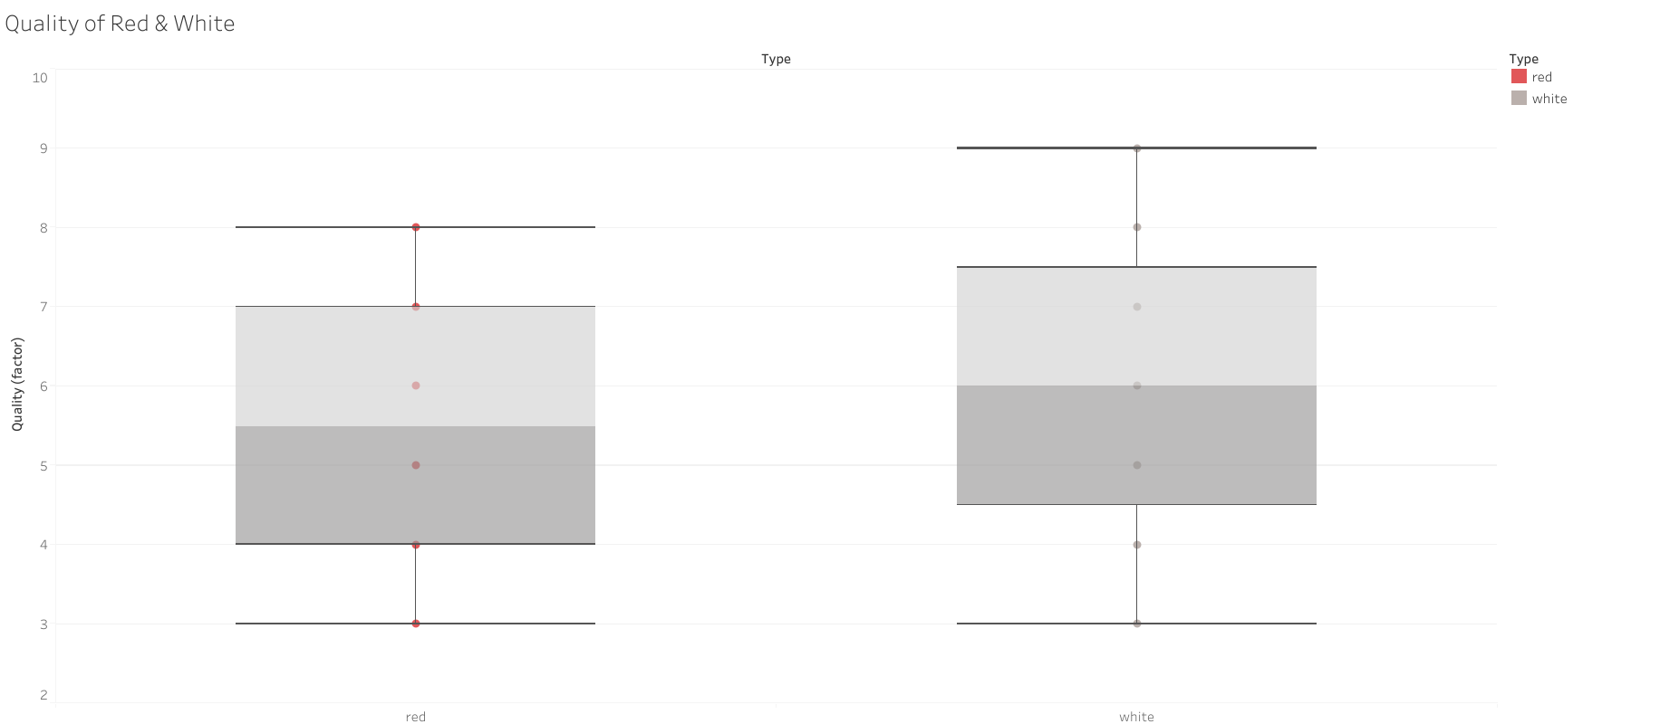
Wine Quality
Red Wine sample: 1600 total White wine sample: 4899

Slide 9
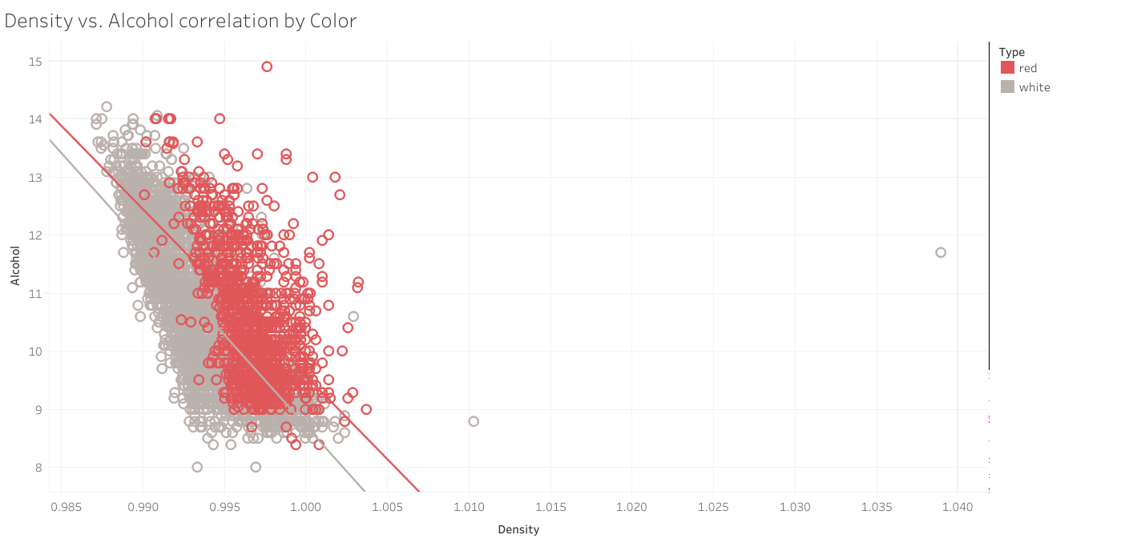
Density and Alcohol correlation
Red wine by average are stronger than white wine. In this dataset wine with less alcohol percentage are mostly white and red has more.

Slide 10
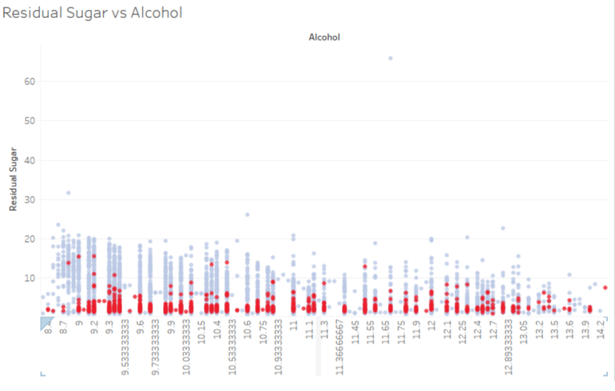
Residual Sugar vs Alcohol

Slide 11
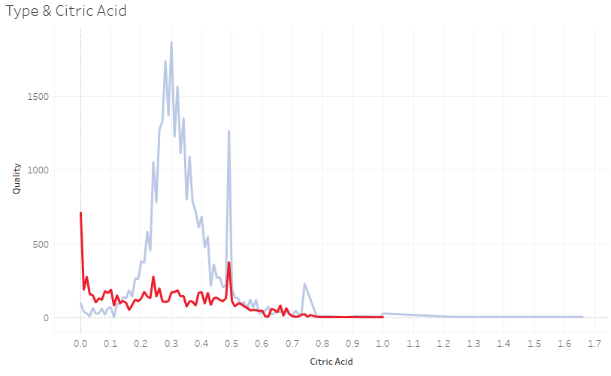
Quality and Citric Acid

Slide 12
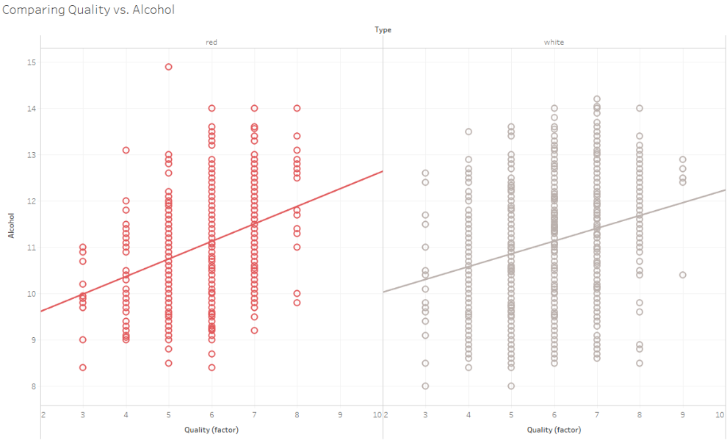
Quality vs Alcohol Content

Slide 13
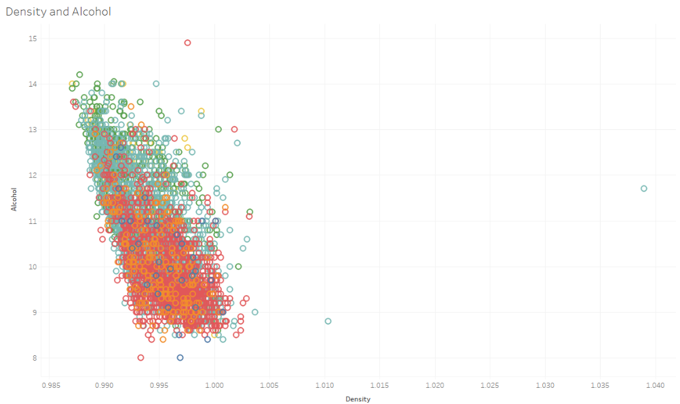
Density and Alcohol

Slide 14
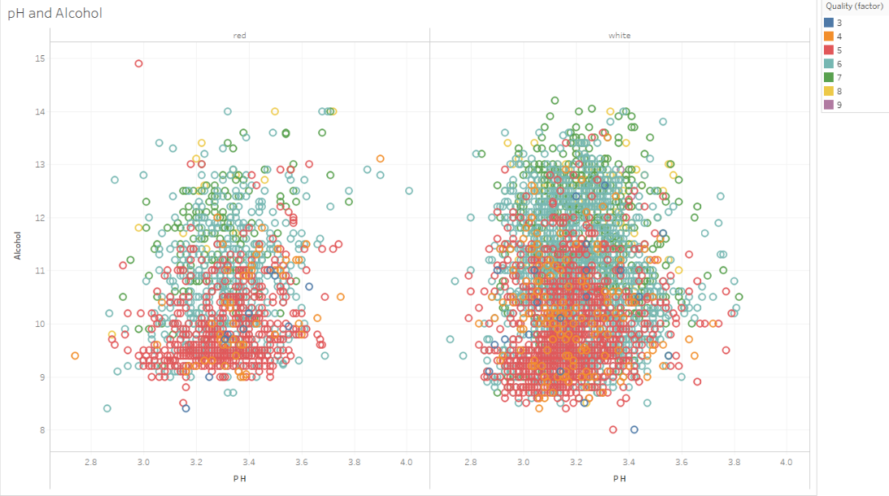
pH and Alcohol

Slide 15
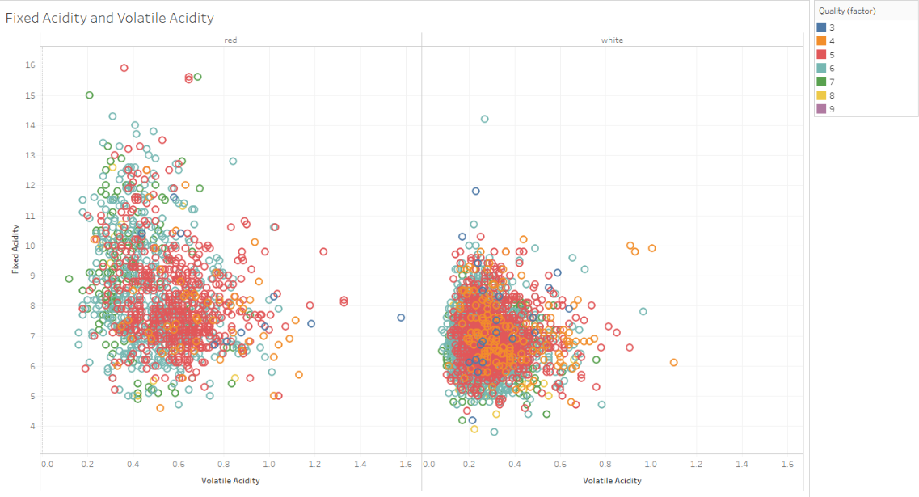
Fixed Acidity and Volatile Acidity

Slide 16
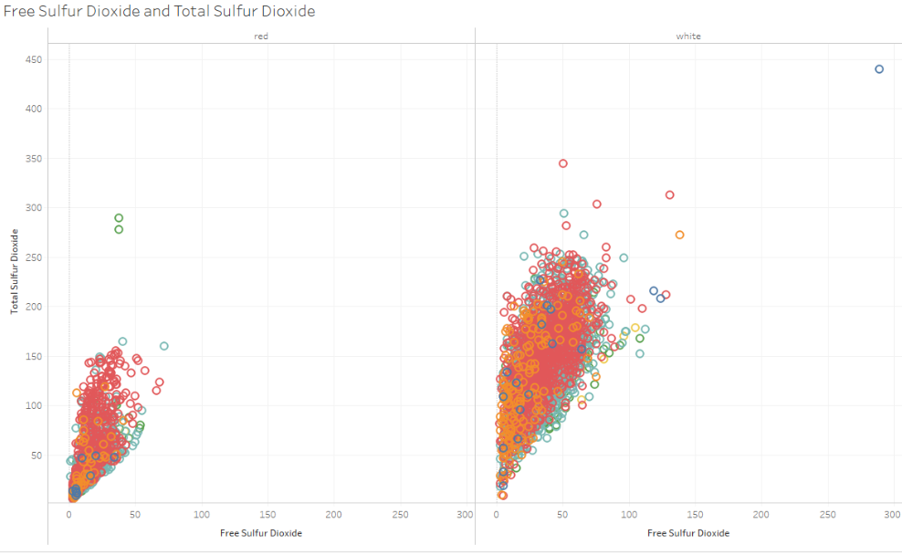
How is Quality Affected?

Slide 17
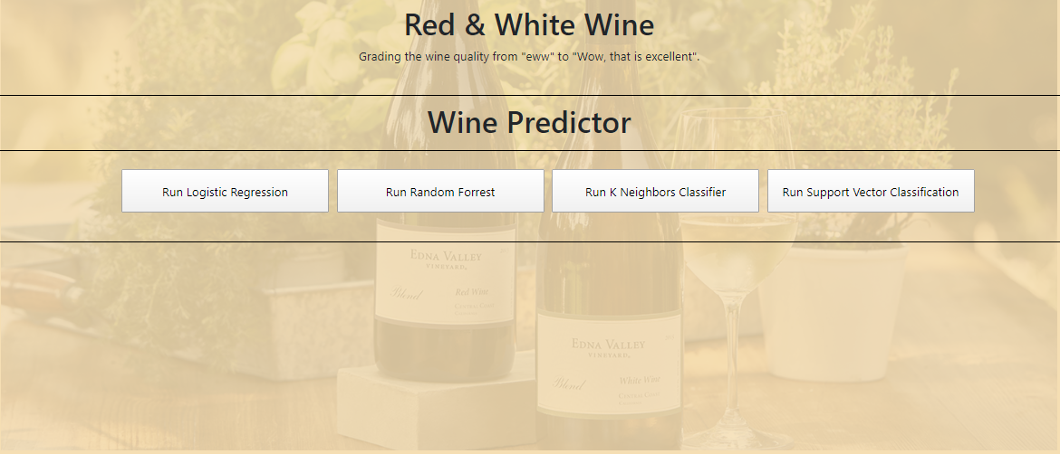
Machine Learning Across Multiple Models

Slide 18
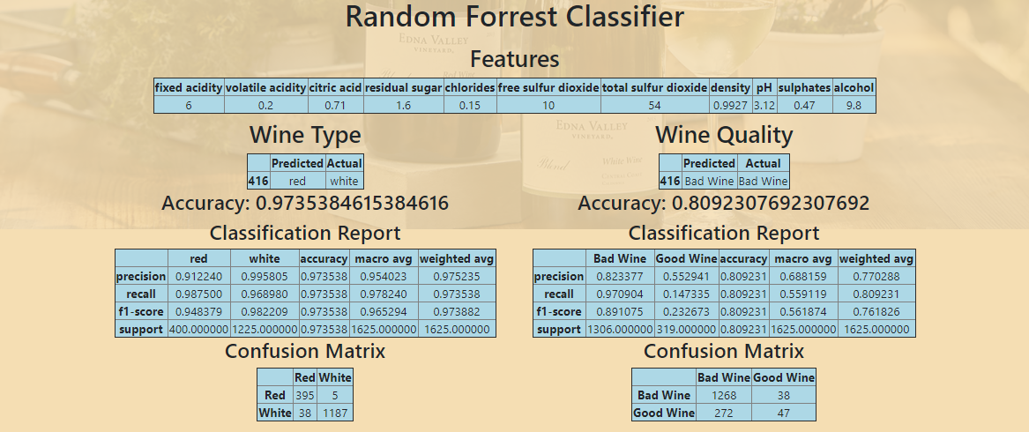
Random Forest
Decision tree is a classification model which works on the concept of information gain at every node. one such very powerful assembling machine learning algorithm which works by creating multiple decision trees and then combining the output generated by each of the decision trees.

Slide 19
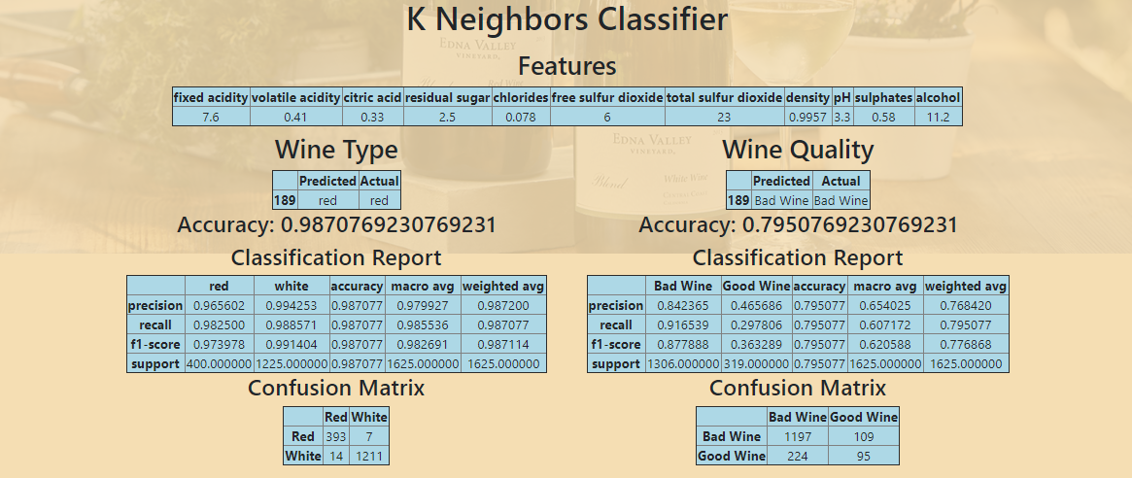
K Neighbors Classifier

Slide 20
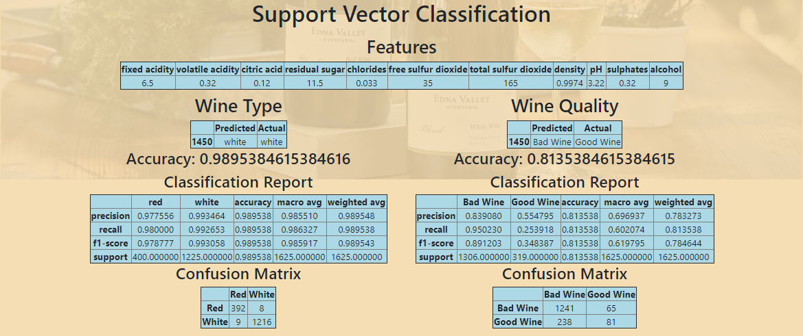
Support Vector Classification
The data classification method that separates data using hyperplanes model.

Slide 21
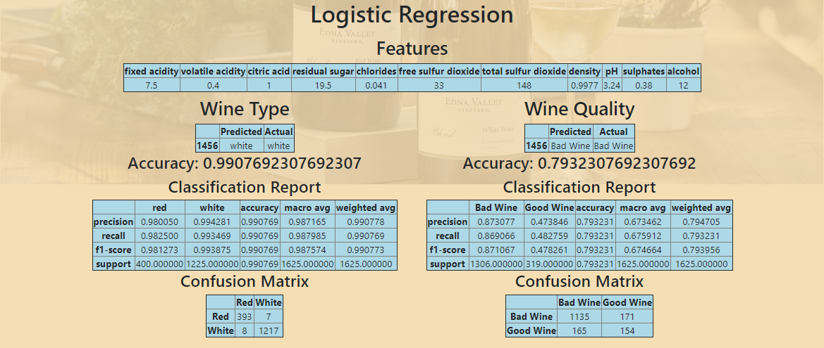
Logistics Regression
Classification algorithm that is used to predict the probability of a categorical dependent variable. In logistic regression, the dependent variable is a binary variable that contains data coded as 1 (yes, success, etc.) or 0 (no, failure, etc.).

Slide 22
Summary and Considerations
Wine Type Ratio
Quality Parameter Ratings
Do the features truly predict quality
Some features predict better than others
Best Features - Fixed Acidity and Volatile acidity (86%)
Worst Features - Total Sulfur Dioxide and Density (70%)
What machine learning can and cannot do

